Slide 1
Kickstarter Classification Project
Karan Goda 460496371

Slide 2
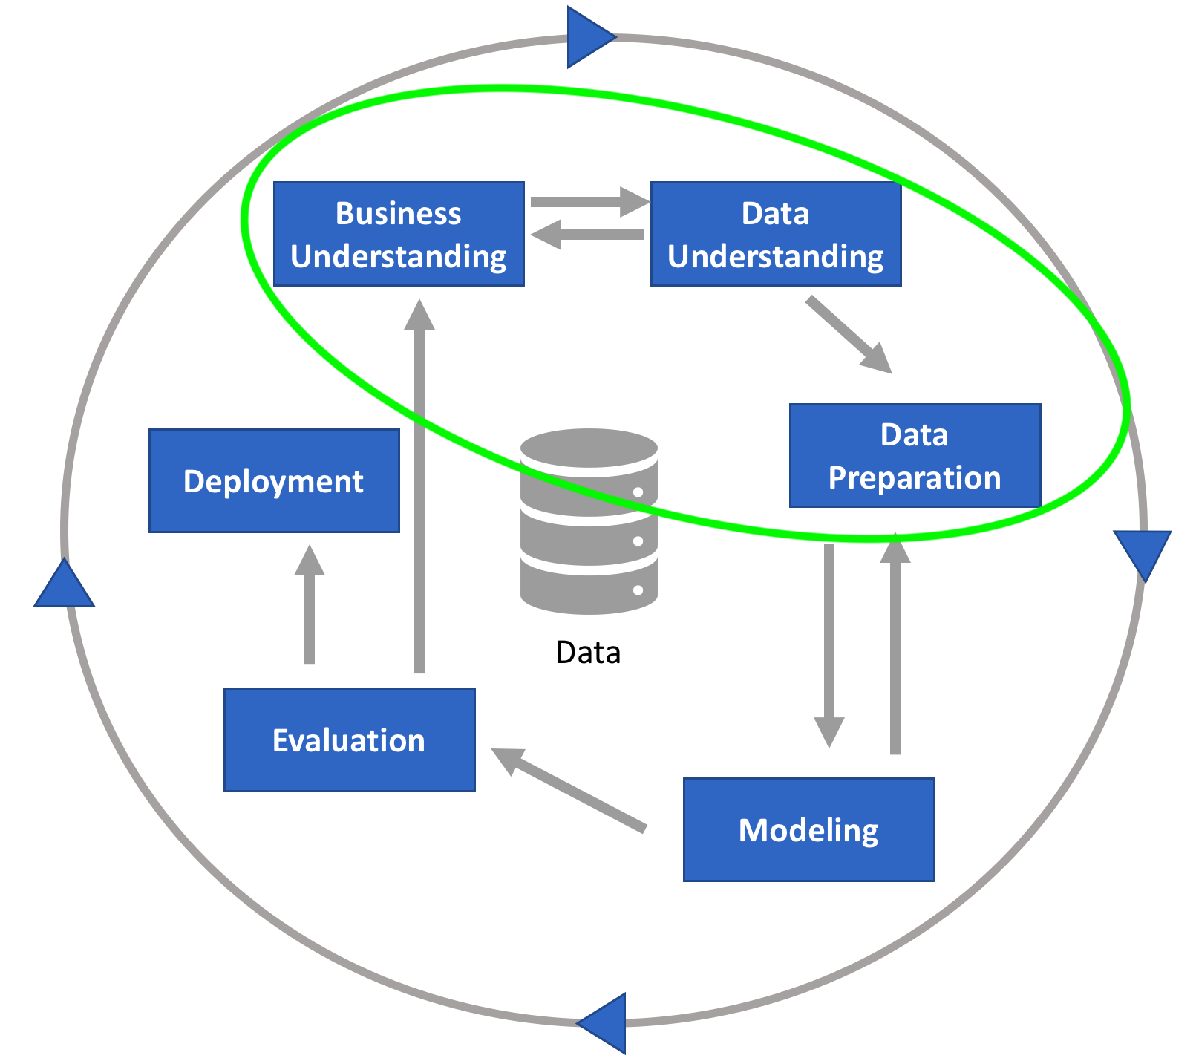
Setup
The dataset is Kickstarter projects and their information.
Research Question: Are we able to use the project’s features such as country or category to predict if the project reaches funding or not.
H0: Baseline values are better than the classifiers.
H1: There is at least one classifier with better results than baseline.
Effectiveness will be measured using F1 score, precision, accuracy.
We are here in the CRISP-DM cycle
Notes:
This slide contains hypotheses, reliability quantification and data

Slide 3
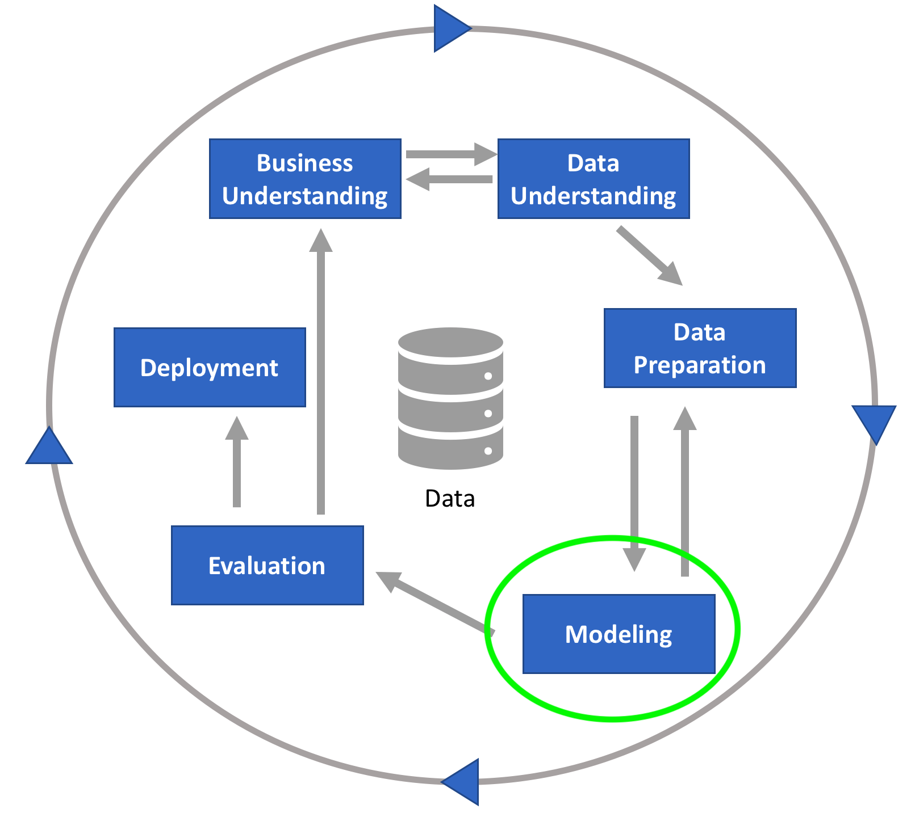
Approach
Supervised methods will be used since datatypes are known
Models we are using are:
Logistic Regression
Linear SVC
Decision Tree
Random Forest
KNN
We are here in the CRISP-DM cycle
Notes:
This and next slide are for approach and experiment setup

Slide 4
Experimental Setup
All the models contains hyperparameters we can tune.
However for most of the models, we will let Jupyter use the default parameters to create the models.
The number of estimators parameter in random forest will be modified to 100.
This increases model effectiveness and decreases overfitting.
We are here in the CRISP-DM cycle

Slide 5
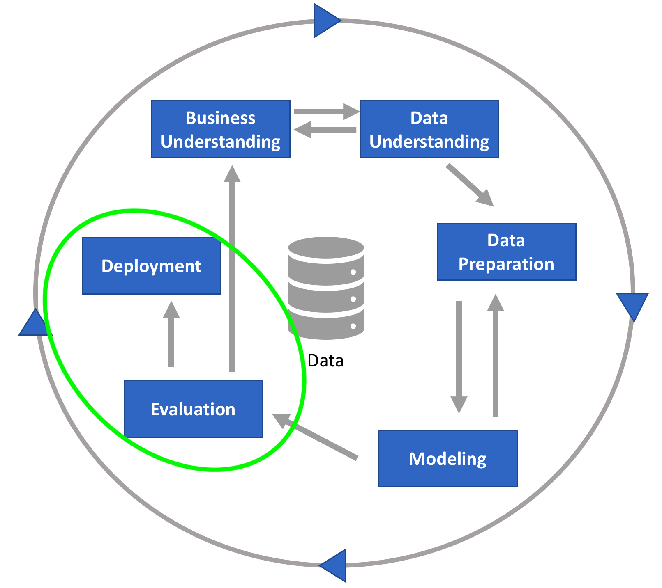
Results
Model | F1 Score | Accuracy Score | Precision Score
Random Forest | 0.579 | 0.633 | 0.593
Decision Tree | 0.534 | 0.587 | 0.540
KNN | 0.531 | 0.600 | 0.548
Logistic Regression | 0.396 | 0.633 | 0.816
Linear SVC | 0.300 | 0.361 | 0.395
Model Scores are well rounded
High Performance
Better than baseline
Best Model is Random Forest
We are here in the CRISP-DM cycle
Notes:
This slide is for results, analysis and discussion.

Slide 6


Thank You!
Notes:
Thank you slide.

